Slide 1
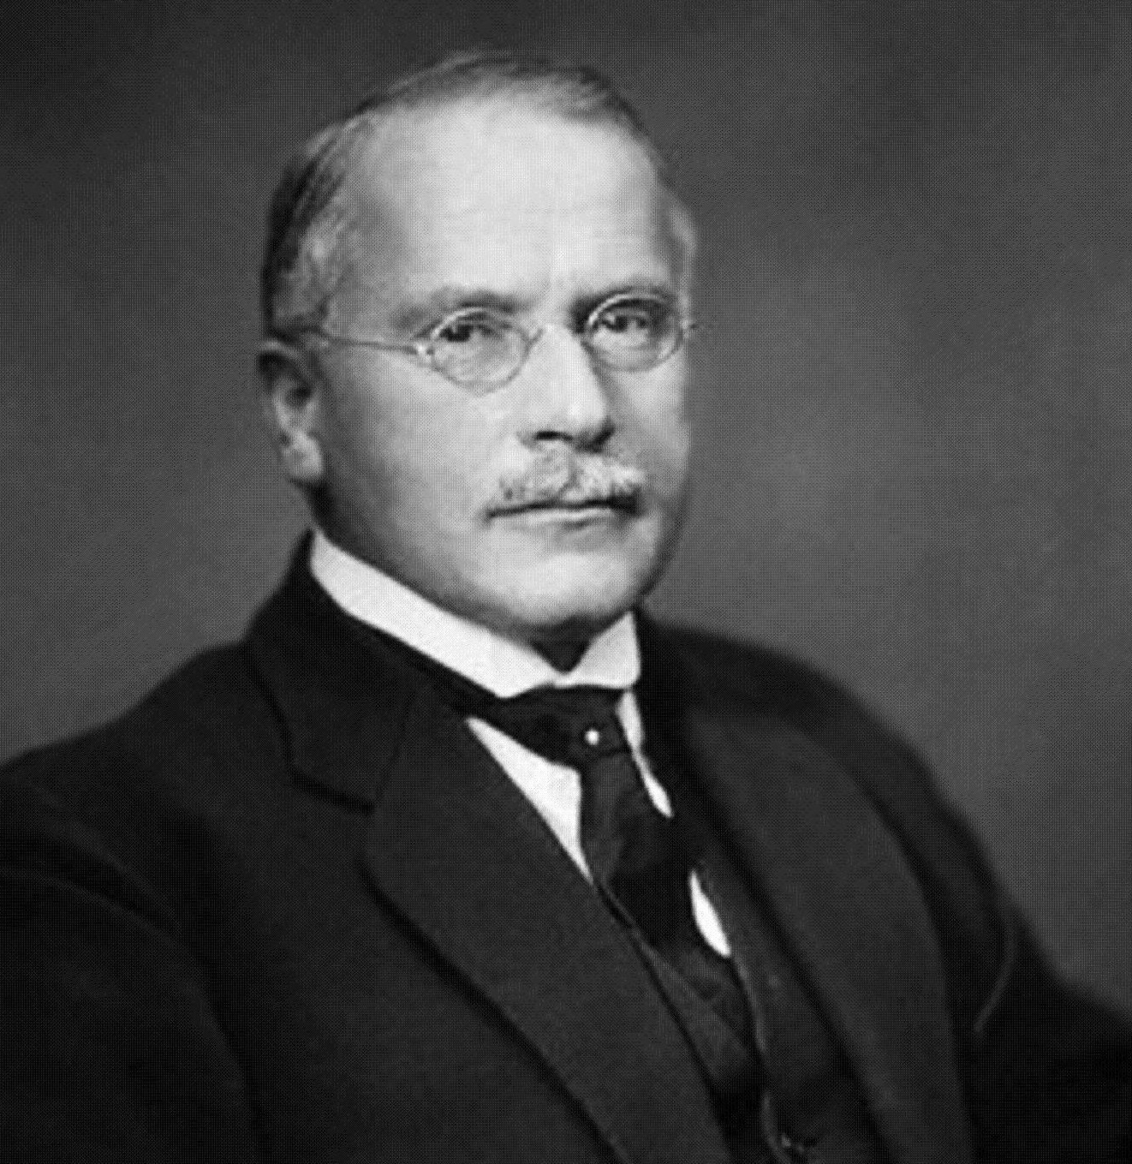
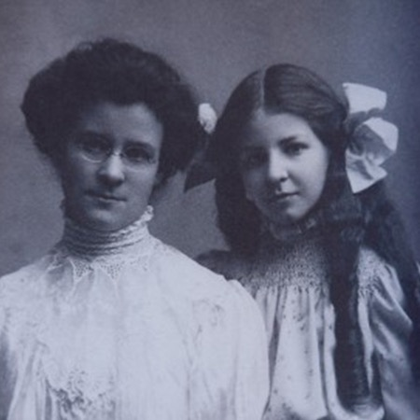
An Adaptation of the
Myers-Briggs Indicator Personality Test

Slide 2
An Adaptation of the
Myers-Briggs Indicator Personality Test
MBTI Personality Test
1.
2.
3.
4.
Notes:
Directions:
Students take out a sheet of paper and number it 1-4 every other line.
On the following slides, students will have a choice between two statements. Students must choose one.

Slide 3
An Adaptation of the
Myers-Briggs Type Indicator(MBTI)
Carl Jung
Isabel Briggs Myers Katharine Briggs
The theory of psychological type was introduced in the 1920s by Carl G. Jung.
The MBTI tool was developed in the 1940s by Briggs & Myers
Notes:
This is NOT the original Myers Briggs Type Indicator(MBTI). This is a adaptation of the original test. The current version of the MBTI includes 93 forced-choice questions. This is much shorter. We can complete in the time of a class period.
The theory of psychological type was introduced in the 1920s by Carl G. Jung. The MBTI tool was developed in the 1940s by Briggs & Myers. Their goal of the MBTI, was to make the insights of Jung’s theory usable to individuals. Since then, additional research and tweaking of the test has brought us to the modern version of the MBTI.

Slide 4
Dichotomy I - How are You Energized
Write A | Write B
Can be described as talkative & outgoing | Can be described as reserved & quiet
Tolerate noise & crowds | Avoids crowds & seeks quiet
Communicate with enthusiasm | Keep enthusiasm to self
Be distracted easily | Concentrate well
Meet people easily & participate in new activities | Proceed cautiously in meeting people & participate in only selected activities
Talks without without thinking | Thinks carefully before speaking
Likes to be in a fast-paced environment | Prefer slower pace with time for contemplation
Likes working or talking in groups. | Would prefer to socialize in small groups or just do the job alone.
Likes to be center of attention. | Content being on the sidelines.
Notes:
For number 1 on your paper, you will read each line, choose whether A or B is more applicable to you and write down your choice. At the end of Dichotomy 1, your sheet should look something like this:
Example:
1. B, B, A, A, B, A, A, A, B

Slide 5
Dichotomy II - How You Gather Information
Write A | Write B
Learn new things by imitation and observation. | Learn new things through general concepts.
Focus on the reality of how thing are | Imagine the possibilities of how things could be
Like to describe things in a specific, literal way | Like to describe things in a figurative, poetic way
Value solid recognizable methods to achieved goals in a step-by-step manner. | Value different or unusual methods to achieved goals by inspiration.
Tend to be specific & literal. Give detailed descriptions. | Tend to be general & figurative, use metaphors & analogies
Behave practically | Behave imaginatively
Rely on past experiences | Rely on hunches
Likes predictable relationships | You value change in relationships
Appreciates usual ways to solve problems | Use new & different ways to solve problems & teach solutions
Value realism & common sense | Value imagination & innovation
Prefer ideas that have practical applications | Enjoy ideas & concepts for their own sake
Notes:
For number 1 on you paper, you will write As and Bs

Slide 6
Dichotomy III - How You Make Decisions & Conclusions
Write A | Write B
Have truth as objective | Have harmony as goal
Decide more with your head | Decide more with your heart
Question other’s findings because they might be wrong | Agree more with other’s findings, because people are worth listening to.
Notice ineffective reasoning. | Notice when people need support.
Choose truthfulness over tactfulness. | Choose tactfulness over truthfulness.
Deal with people firmly as needed. | Deal with people compassionately.
Expect the world to run on logical principles | Expect the world to recognize individual differences.
Make decisions in an impersonal way, using logical reasoning | Base your decisions on personal values & how your actions affect others
Believe feelings valid if they're logical. | ANY feeling is valid.
Enjoy finding flaws in an argument | Like to please others & point out the best in people
Could be described as reasonable & level headed | Could be described as warm & empathetic
Notes:
For number 1 on you paper, you will write As and Bs

Slide 7
Dichotomy IV - Has to do with the Lifestyle you choose
Write A | Write B
Prefer my life to be decisive by imposing my will on it. | Seek to adapt my life and experience to what comes along.
Make plans, want to know what you’re getting into. | Are spontaneous, enjoy surprises, & new situations
Feel better after making decisions. | Prefer to keep things open.
Enjoy finishing things. | Enjoy starting things.
Prefer to have matters settled | Prefer to leave your options open so nothing is missed.
Think rules & deadlines should be respected | See rules & deadlines as flexible
Dislike surprises and want advance warnings. | Enjoy surprises and like adapting to last-minute changes.
See time as a finite resource and take deadlines seriously. | See time as a renewable resource and see deadlines as elastic.
Like checking off "to do" list. | Ignore "to do" list even if I made one.
Feel better with things planned. | Would rather do whatever comes along.
Settled. Organized. | Tentative. Flexible. Spontaneous.
Notes:
For number 1 on you paper, you will write As and Bs

Slide 8
Score Time
Count the As and Bs for each slide and place your totals on the right
Your Name
Per. 1
Psychology
Personality test
E N F P
1. A A A A B A B A A B A=7 B= 3
2. A B B B A B B B B B A=2 B= 8
3. B A B B B A B A B B A=3 B= 7
4. A A B B B B B B A B A=3 B= 7
E
N
F
P
On line 1, if you have more A’s write an E to the left, if you have more B’s write an I
On line 2, if you have more A’s write an S to the left, if you have more B’s write an N
On line 3, if you have more A’s write a T to the left, if you have more B’s write an F
On line 4, if you have more A’s write a J to the left, if you have more B’s write a P
The personality type for the example above is ENFP.
Notes:
Count the As and Bs for each slide and place your totals on the right

Slide 9
An Adaptation of the
Myers-Briggs Indicator Personality Test
According to Carl Jung's typology all people can be classified using three criteria.
1. Extraversion - Introversion
2. Sensing - Intuition
3. Thinking - Feeling
4. Judging - Perceiving - Isabel Briggs-Myers added this fourth
- 1st criterion defines the source and direction of energy expression for a person.
Extrovert has a source and direction of energy expression mainly in the external world while the
Introvert has a source of energy mainly in the internal world.
- 2nd criterion defines the method of information perception by a person.
Sensing means that a person believes mainly information they receive directly from the external world.
INtuition means that a person believes mainly information they receive from the internal or imaginative world.

Slide 10
An Adaptation of the
Myers-Briggs Indicator Personality Test
According to Carl Jung's typology all people can be classified using three criteria. Extraversion - Introversion
Sensing - Intuition
Thinking - Feeling
Judging - Perceiving
- 3rd criterion defines how the person processes information.
Thinking means that a person makes a decision mainly through logic.
Feeling means that, as a rule, they makes a decision based on emotion.
- 4th criterion defines how a person implements the information he has processed.
Judging means that a person organizes all their life events and acts strictly according to their plans.
Perceiving means that they are inclined to improvise and seek alternatives.

Slide 11
An Adaptation of the
Myers-Briggs Indicator Personality Test
Famous ISTPs: Steve Jobs, James Dean, Clint Eastwood, Dalai Lama, Vladimir Putin, Ron Paul, Harrison Ford, Scarlett Johansson
Famous ISTJs: George Washington, Herbert Hoover, George H. W. Bush, Matt Damon, Natalie Portman
Famous ISFPs: Michael Jackson, Ulysses S. Grant, Marilyn Monroe, Jonathan Ive, Paul McCartney, Justin Timberlake, Brad Pitt
Famous ISFJs: Jimmy Carter, Mitt Romney, Charles Dickens, Robert E. Lee, Halle Berry, Gwyneth Paltrow, Tiger Woods, 50 Cent
Famous INTPs: Socrates, Abraham Lincoln, Isaac Newton, Dwight D. Eisenhower, Tina Fey, Albert Einstein, Larry Page(co-founder of google)
Famous INTJs: Jane Austen, Mark Zuckerberg, Jr., Stephen Hawking, Martin Luther, Jay-Z, Julia Stiles, Russell Crowe.
Famous INFPs: J.K. Rowling, Louis C.K, Vincent van Gogh, John Lennon, Johnny Depp, Morrissey, Andrew Garfield(Spider-man)
Famous INFJs: Mother Teresa, Edward Norton, Cate Blanchett, Martin Luther King, Jr., Michelle Pfeiffer, Carl Jung, Mahatma Gandhi.

Slide 12
An Adaptation of the
Myers-Briggs Indicator Personality Test
Famous ESTPs: Donald Trump, George W. Bush, Malcolm X, Angelina Jolie, Madonna, Ben Affleck, Megan Fox, Michael J. Fox, Taylor Swift
Famous ESTJs: Andrew Jackson, Hillary Clinton, Dr. Phil, Martha Stewart, Sonia Sotomayor, Alec Baldwin, Michelle Obama
Famous ESFPs: Bill Clinton, John F. Kennedy, Steven Spielberg, Beyonce, Will Smith, Katy Perry, Kathy Lee Gifford, Cameron Diaz.
Famous ESFJs: Colin Powell, Harry S. Truman, Pope Francis, Jason Segal, Jessica Alba, Prince William, Vin Diesel, Hugh Jackman,
Famous ENTPs: Teddy Roosevelt, Thomas Edison, Julia Child, Barack Obama, Stephen Colbert, Bill Maher, Jon Stewart, Salma Hayek
Famous ENTJs: Franklin D. Roosevelt, Richard M. Nixon, Sigourney Weaver, Margaret Thatcher, Al Gore, Carl Sagan, George Clooney, Adele
Famous ENFPs: Mark Twain, Dr. Seuss, Benjamin Franklin, Hunter S. Thompson, Walt Disney, Ellen DeGeneres, Gwen Stefani, Jennifer Aniston
Famous ENFJs: Neil deGrasse Tyson, Joe Biden, Nelson Mandela, Reese Witherspoon, Oprah, Jennifer Lawrence, Michael Moore

Slide 13
Personality
An Adaptation of the
Myers-Briggs Indicator Personality Test
Descriptions

Slide 14
-ISTP. You are centered on the inside world, a person of thoughts and (sometimes) emotions. You prefer dealing with the present and factual, using logic to make decisions. You are flexible, open, practical, quiet, detached, organized, and reasonably adaptable. You are also curious and maybe impulsive. You sometimes create unexpected ideas with surprising results.
-ISTJ. You are centered on the inside world, a person of thoughts and (sometimes) emotions. You prefer dealing with the present and factual, using various options to make decisions. You are organized, logical, quiet, and serious. You are also a keen observer of life, well prepared for most eventualities, and have a good understanding of most situations. You believe in practical objectives.
-ISFP. You are centered on the inside world, a person of thoughts and emotions. You prefer dealing with the present and factual, using personal values to make decisions. You are reasonably adaptable, quiet, and friendly. You like to interact with small groups of people, and have a caring and sensitive approach to others. You also like to avoid confrontation or conflict, and tend to operate as a supportive team player.
ISFJ. You are centered on the inside world, a person of thoughts and emotions. You prefer dealing with the present and factual, using personal values to make decisions. You are organized, quiet, and a serious observer of people. You like to help others, and are conscientious and loyal. You also like to avoid confrontation or conflict, and tend to be perceptive and sensitive of others' feelings.

Slide 15
INTP. You are centered on the inside world, a person of thoughts and (sometimes) emotions. You prefer dealing with patterns and possibilities, using logic to make decisions. You are flexible, open, quiet, detached, and reasonably adaptable. You do not like routine, and will experiment to see if things can be improved. You enjoy complex problems and using your intellect.
-INTJ. You are centered on the inside world, a person of thoughts and (sometimes) emotions. You prefer dealing with patterns and future possibilities, using impersonal analysis to make decisions. You are a strategist, organized and logical. You prefer identifying long term goals and working towards them. You tend to be skeptical, critical, competent, and have a strong, detail-oriented intellect.
INFP. You are centered on the inside world, a person of thoughts and emotions. You prefer dealing with patterns and possibilities, using personal values to make decisions. You are flexible, open, and creative. You are also quiet and adaptable, interested in new ideas, and prefer work that is meaningful and makes a creative contribution to life. You like people (though often you express this quietly) and have a desire to see others grow and develop.
INFJ. You are centered on the inside world, a person of thoughts and emotions. You prefer dealing with patterns and possibilities, using personal values to make decisions. You are organized, often with a private sense of purpose, and work steadily towards fulfilling your goals. You have a quiet concern for people, like to help them grow, and often have a good insight into others (frequently not expressed).

Slide 16
ESTP. You are centered on the outside world, a person of actions and spoken words. You prefer dealing with the present and factual, using logic and objectivity to make decisions. You are flexible, practical, organized, and a problem-solver. You can also be impulsive, and can sometimes neglect follow-through. But you thrive on lots of activity, especially the kind which requires action and organization.
-ESTJ. You are centered on the outside world, a person of actions and spoken words. You prefer dealing with the present and factual, using logic to make decisions. You are practical, traditional, and businesslike. You are detail-oriented, and prefer to use trusted concepts, rather than untested ideas and strategies.
-ESFP. You are centered on the outside world, a person of actions and spoken words. You prefer dealing with the present and factual, and enjoy having friendships with people. You are flexible, spontaneous, impulsive, and make new friends easily. You often work best in practical situations involving others, or in dealing with urgent problems, such as fire-fighting or trouble shooting.
-ESFJ. You are centered on the outside world, a person of actions and spoken words. You prefer dealing with the present and factual, using personal values to make decisions. You are very warm, friendly, and like dealing with people. You often find conflict or criticism difficult to handle, but have a strong sense of obligation and loyalty. You also have a powerful desire to be of service to others.

Slide 17
ENTP. You are centered on the outside world, a person of actions and spoken words. You prefer dealing with patterns and possibilities, using logic to make decisions. You are adaptable, very open to new ideas, especially about improving your competence or skill. You can be an ingenious problem solver, and can enjoy a good argument. You are interested in change, like to overcome new difficulties, and tend to employ creative applications in life and work.
-ENTJ. You are centered on the outside world, a person of actions and spoken words. You prefer dealing with patterns and possibilities, using various courses of action to make decisions. You are organized, logical, and prefer to control life, often taking the role of executive or director. You have a business-like and impersonal approach, sometimes appearing intolerant of people without the same high standards.
ENFP. You are centered on the outside world, a person of actions and spoken words. You prefer dealing with patterns and possibilities, using personal values to make decisions. You are flexible, open, creative, insightful, and people-oriented. You like working toward a general goal, using variety and experimentation, though sometimes you may neglect details and planning.
-ENFJ. You are centered on the outside world, a person of actions and spoken words. You prefer dealing with patterns and possibilities, using personal values to make decisions. Your life is organized, highly sociable, and expressive of feelings. You seek to develop stable relationships with people. You also find it difficult to deal with conflicts or criticism, especially in long-term relationships. You like situations involving people.

