Slide 1
Literary terms

Slide 2
Allegory
An allegory is a story, poem, or picture that can be interpreted to reveal a hidden meaning, typically a moral or political one.

Slide 3
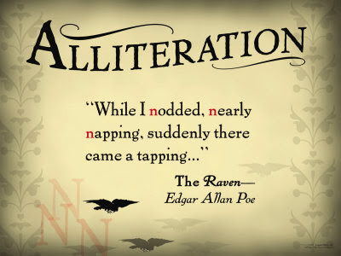
Alliteration
Repetition of the same or similar consonant sounds in words that are close together.
Example:

Slide 4
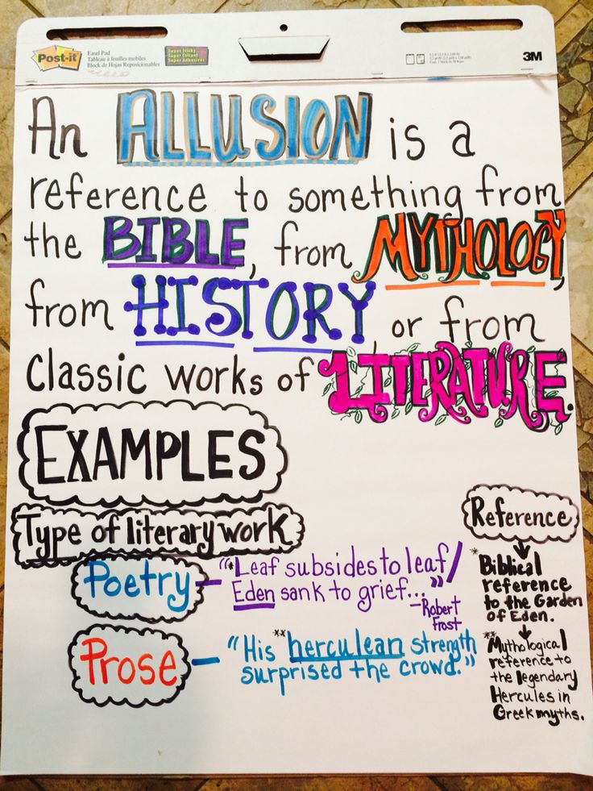
Allusion
A brief and indirect reference to a person, place, thing or idea of historical, cultural, literary or political significance.
It does not describe in detail the person or thing to which it refers. It is just a passing comment and the writer expects the reader to possess enough knowledge to spot the allusion and grasp its importance in a text.
Some examples in everyday speech:
“Don’t act like a Romeo in front of her.”
“This place is like a Garden of Eden.”

Slide 6
What’s the point?
An inside joke
To connect two texts
To add interest to writing

Slide 7
Biblical Allusions

Slide 8
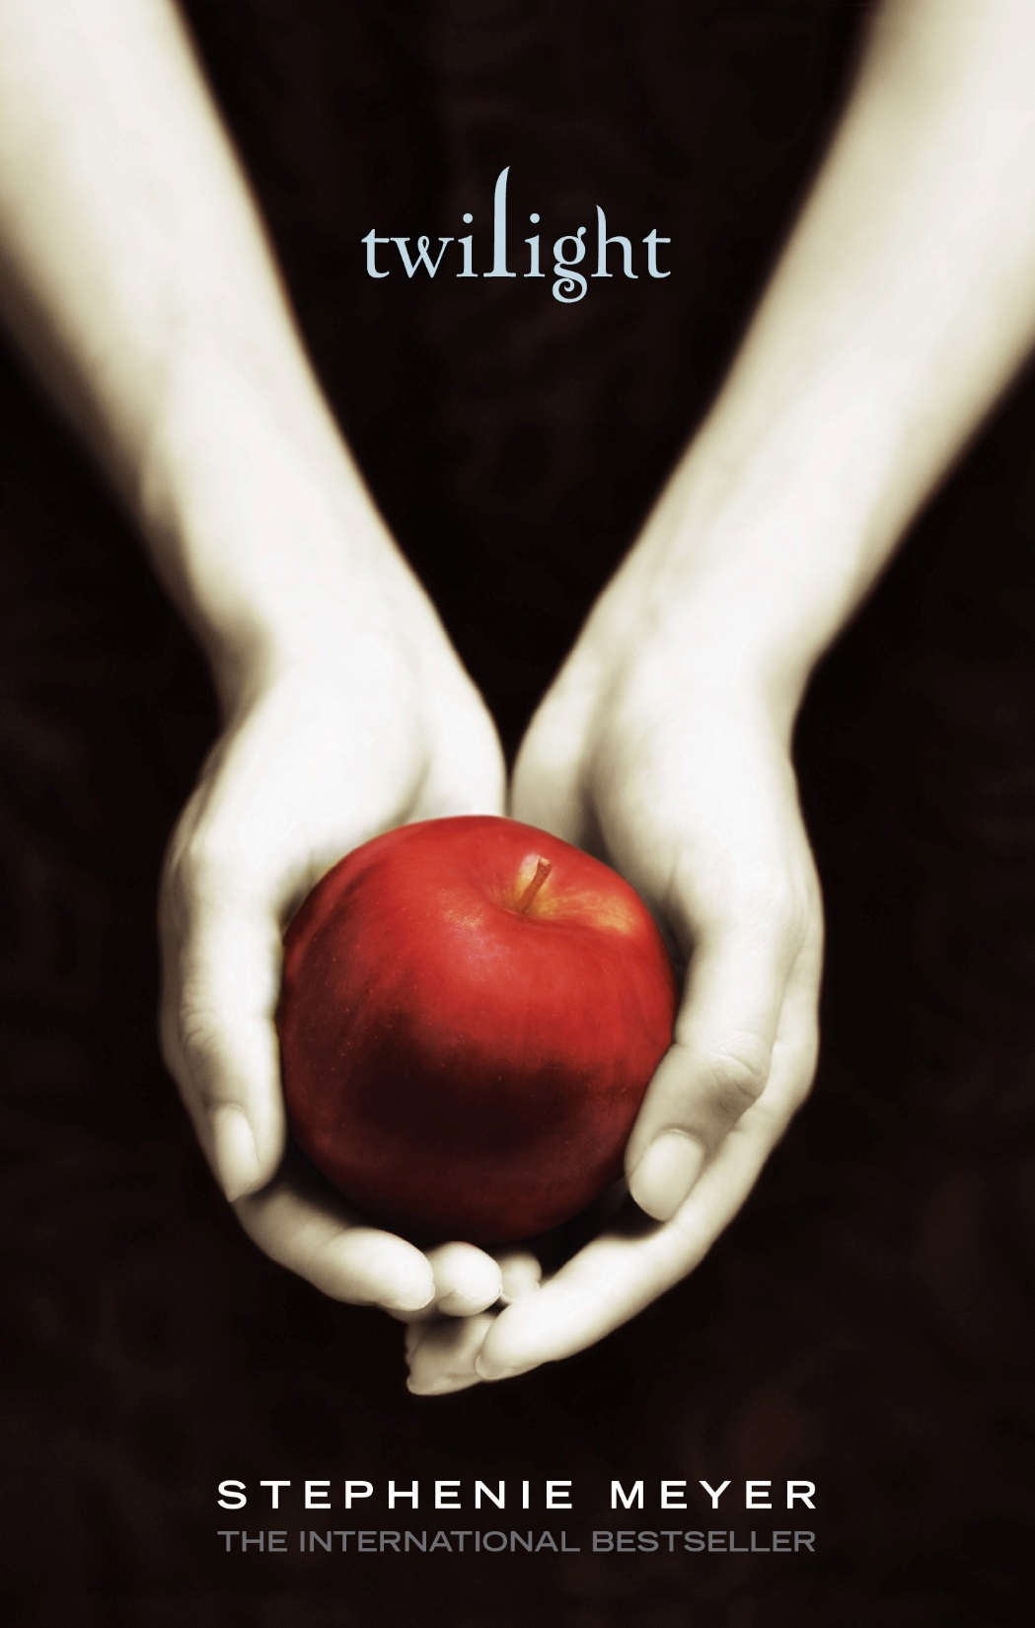

Slide 10
Mythological Allusions
Chocolate is my Achilles heel
In Greek Mythology, Achilles’ only vulnerable spot was his heel (it was the only way he could be defeated)

Slide 11
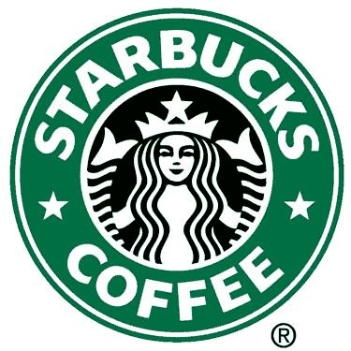
The woman in the Starbucks logo is a Siren. In Greek mythology, the Sirens are creatures with the head of a female and the body of a bird. Later in history, Sirens appeared as half female and half fish. They lived on an island and lured sailors to their deaths (Siren Song)
The Starbuck’s Siren is drawn as half female and half fish because she represents the company’s hometown, the coast of Seattle, Washington. Why did Starbucks choose a Siren?

Slide 12
Shakespearean Allusions
Romeo and Juliet (a tale of forbidden love)
Taylor Swift’s “Love Story”
Hamlet (a son seeks revenge for his father’s murder)
“The Lion King”

Slide 13
Memes as Allusions
If you weren’t reading To Kill A Mockingbird, you would not get any of these

Slide 20
Spot the Allusions
https://www.youtube.com/watch?v=dIEMFdX32Dw&safe=active

Slide 21
Antagonist
Opponent who struggles against or blocks the hero, or protagonist, in a story

Slide 22
Cliché
A word or phrase, often a figure of speech, that has become lifeless because of overuse. Avoid clichés like the plague. (Note: That cliché is intended.)
Examples:
At the speed of light
Absolute power corrupts absolutely
Actions speak louder than words
All bent out of shape
Near and dear to my heart

Slide 23
Colloquialism
A word or phrase in everyday use in conversation and informal writing but is inappropriate for formal situations.
Example: “He’s out of his head if he thinks I’m gonna go for such a stupid idea.

Slide 24
Connotation
The associations and emotional overtones that have become attached to a word or phrase, in addition to its strict dictionary definition.
The deeper meaning of a word or phrase
Example: Dove

Slide 25
Denotation
The literal or dictionary meanings of a word in contrast to its connotative or associated meanings
Example: Dove

Slide 26
Diction
A speaker’s or writer’s choice of words
Develops the style of writing, also the overall mood and feeling of the piece

Slide 27
Foil
A character who acts as contrast to another character.
Often a funny side kick to the dashing hero, or a villain contrasting the hero.
The foil character further reveals or illuminates the characteristics of a main character
Example: Homer Simpson and Ned Flanders

Slide 28
Foreshadowing
The use of hints and clues to suggest what will happen later in a plot

Slide 29
Hyperbole
A figure of speech that uses an incredible exaggeration or overstatement, for effect.
Example: “If I told you once, I’ve told you a million times….”

Slide 30
Imagery
Descriptive language used to represent objects, actions and ideas in such a way that it appeals to all of our physical senses.
Imagery in writing draws the reader into the story or poem, and allows the reader to imagine they are experiencing the story:

Slide 34
Read the following examples of imagery carefully and identify the sense that it conveys:
It was dark and dim in the forest.
The children were screaming and shouting in the fields.
He whiffed the aroma of brewed coffee.
The girl ran her hands on a soft satin fabric.
The fresh and juicy oranges are very cold and sweet.

Slide 35
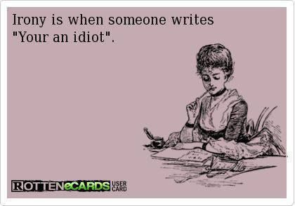

Slide 36
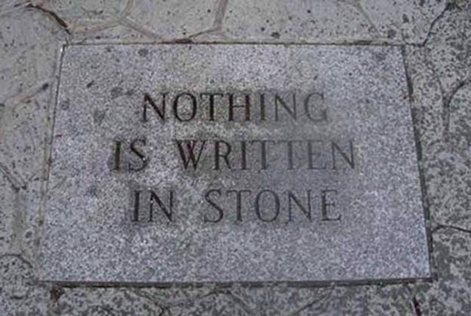

Slide 37
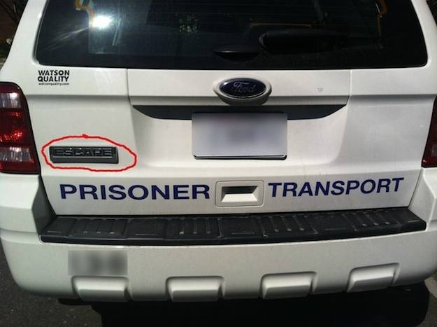

Slide 38
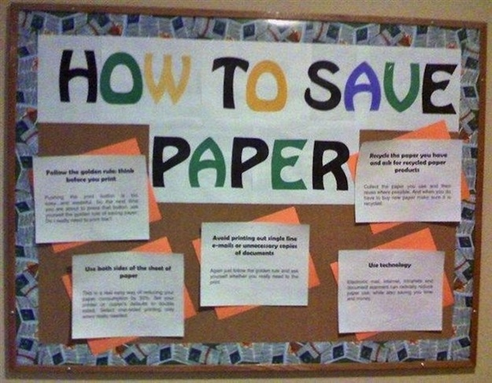

Slide 39
Irony
IRONY a discrepancy between appearances and reality.
3 TYPES:
Verbal
Situational
Dramatic

Slide 40
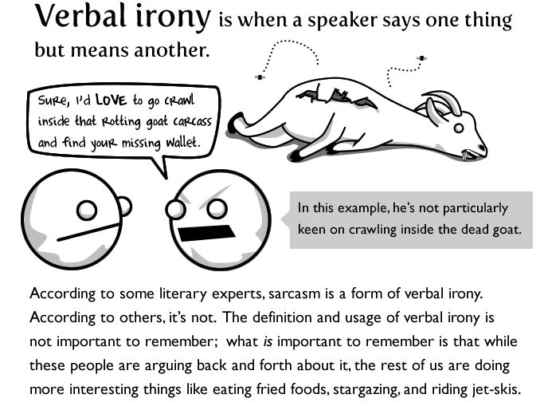

Slide 41
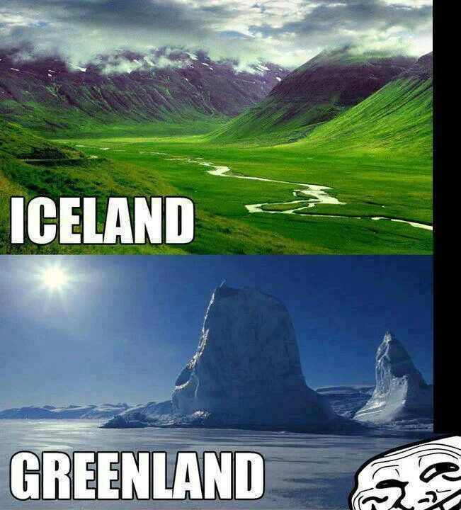
Situational irony
SITUATIONAL IRONY takes place when there is a discrepancy between
what is expected to happen, or what would be appropriate to happen, and what
really does happen.

Slide 42
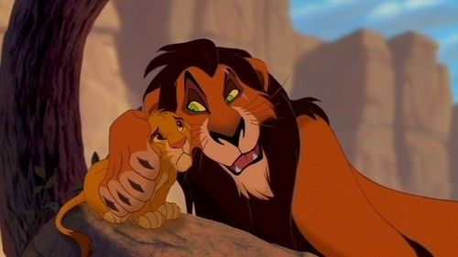
DRAMATIC IRONY
DRAMATIC IRONY is so called because it is often used on stage. A
character in the play or story thinks one thing is true, but the audience or reader
knows better.

Slide 43
Metaphor
A figure of speech that makes a comparison between two unlike things without the use of such specific words of comparison as like, as, than, or resembles.

Slide 44
Protagonist
The hero or main character of a story

Slide 45
Pun
A “play on words” based on the multiple meanings of a single word or on words that sound alike but mean different things.
By playing with the words, the writers reveal their cleverness and the cleverness of their characters. Besides, puns in a literary works act as a source of comic relief or an intentional effort on the part of the writer to show his/her creative ability in using language.
Examples:
A horse is a very stable animal.
Time flies like an arrow. Fruit flies like a banana.

Slide 46
Satire
A type of writing that ridicules the shortcomings of people or institutions often in an attempt to bring about a change.

Slide 47
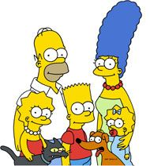
Pop Culture: examples of satire
Scary Movie
The Simpsons
South Park
Austin Powers
Saturday Night Live
Political Cartoons
Sesame Street

Slide 48
Simile
A figure of speech that makes an explicitly comparison between two unlike things, using words such as like, as , than, or resembles.

Slide 49
Symbol
A person, place, thing, or event that has meaning in itself and that also stands for something more than itself.
Adds a deeper meaning to the story

Slide 50
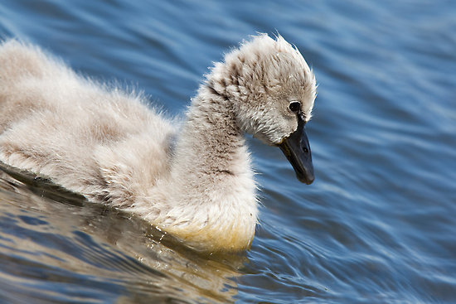

Slide 52
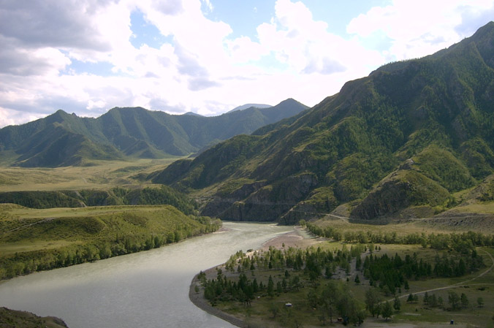

Slide 53
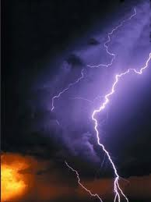
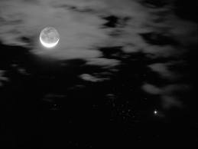
In literature, symbols are full of meaning and are used to develop atmosphere in the text.
Example: A storm occurring when there is a conflict or high emotions
Example: Transition from day
to night might = move from
goodness to evil
* Example: And dawn may show the end of conflict, the “start of a new day.”

Slide 54
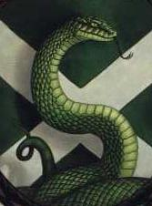
Examples from literature
Harry Potter (lots of symbolism)
A snake represents ___________!
It is no coincidence then that the symbol of Slytherin House is a serpent.

